Slide 1
Teachers,
Feel free to use and share.
File---> Make a copy and it’s yours to edit, adjust to your needs, etc.
Don’t worry about giving me credit. Just use the resources responsibly.
Happy teaching and learning!
--Jenna
Jenna Reeh
Instructional Technology Facilitator
Papillion LaVista Community Schools
@KrambeckReeh
jreeh@paplv.org

Slide 3
Key Terms To Know
Host: The meeting host is the person who has scheduled the meeting. The host has control over all functions and features in the meeting.
Attendee: When you join a Zoom meeting hosted by another user, you are considered an attendee.
Navigation toolbar: Toolbar featured on the left hand side of the screen on the web version of Zoom. Includes: profile, meetings, webinar, recording, settings, account profile, and reports.
Key Icons
Click on this icon to mute and unmute yourself during discussion.
Click on this icon to turn on and off your camera.
Options for inviting attendees via email or a web link.
Options for managing engagement and participation, along with muting participants
Options for sharing your screen, browser, a whiteboard, or a document.
Assign participants into groups for group work or discussion. Can be assigned manually or automatically
Ends the meeting. Be sure to select “End Meeting for All” so that students are not left in the room unsupervised.

Slide 4
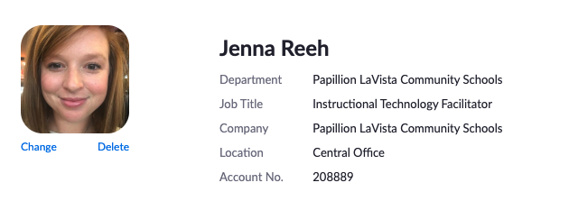
Getting Started
Task Card #1
Goal:
Sign-in to your pre-created account and add a profile picture.
Navigate to https://zoom.us.
In the top right hand corner of the website select “sign in.”
Select the button “Sign in with Google.”
Select your PLCS email address
On the navigation toolbar select “Profile.”
Select “Change.”
Upload a picture of yourself or your school’s logo. (This is what participants will see when you are not on camera.)
Adjust your information to reflect your role and school.

Slide 5
Managing Your Settings
Task Card #2
Goal:
Adjust your settings to what is recommended for school use.
On the navigation toolbar select “Settings.”
There are three menus: meeting, recording, and telephone.
Adjust the following settings (all others can remain in their default.)
Meetings
Host video- off
Participant video- off
Join Before Host- off
Use Personal Meeting ID (PMI) when scheduling a meeting- on
Use Personal Meeting ID (PMI) when starting an instant meeting- on
Embed password in meeting link for one-click join- off
Mute participants upon entry- on
Upcoming meeting reminder- on
Chat- off
Play sound when participants join or leave- on (heard by host only)
Feedback to Zoom- off
Screen sharing- on (host only)
Whiteboard- on
Remote control- off
Nonverbal feedback- on
Show a “Join from your browser” link- on
Recording
Local recording- off (You can choose to enable it, but know that these files are large and will take up space on your laptop.)
Telephone
Mask phone number in the participant list- on (This needs to be turned off. If this setting is enabled students who join via phone may be disclosing their phone number to other participants.)

Slide 6
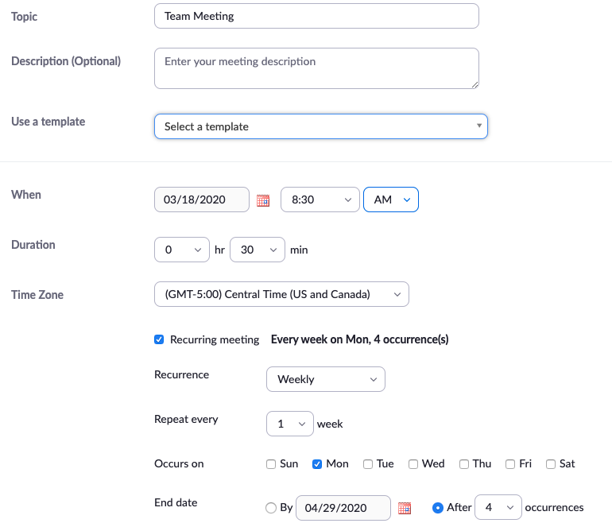
Schedule a Meeting
Task Card #3
Goal:
Practice scheduling a meeting.
In the navigation menu select “Meetings.”
Select “Schedule a New Meeting”
Title the meeting “Team Meeting.”
Schedule the meeting for today at 12:30 p.m. and make it last 30 minutes.
Make the meeting recur every Monday for the next four weeks.
Ensure that the video feed for hosts and participants are off when entering the meeting.
Disable attendees from joining the meeting before the host.
Turn off the participant’s microphone so you don’t hear them until they want to be heard.
Save your meeting.

Slide 7
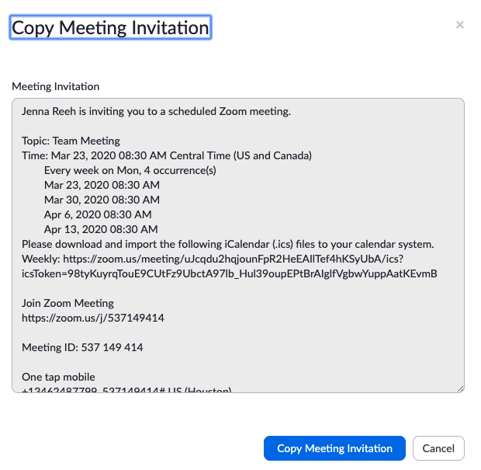
Share Your Meeting with Others
Task Card #4
Goal:
Practice inviting at least one person to a meeting.
Now that you’ve created a meeting you need to invite attendees. Navigate to “Meetings” in the navigation menu.
Find the meeting you created. Click on the hyperlinked title.
In the row titled “Join URL” click on the “Copy the Invitation button.
A pre-populated message will appear. Click the blue button titled “Copy Meeting Invitation.”
Navigate to your email. Compose an email in Outlook.
Paste the message.
Edit the message to only include the topic, time/date, join meeting link, and meeting ID. (The other information is for international calls and can be deleted.)
Add any attendees that are invited to be a part of the meeting.

Slide 8
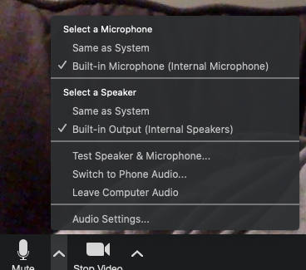
Hosting: Starting a Meeting
Task Card #5
Goal:
Make sure your microphone and webcam work.
Click on the “Meetings” tab in the navigation toolbar.
Find the meeting you created and click “Start.”
Several pop ups will appear on your desktop. Click “Join with Computer Audio on the top pop up.
Test your microphone by clicking on the up arrow next to the microphone and selecting “Test Speaker & Microphone.”
Say “Hello” laud enough to see the microphone light up green. (Make sure the microphones two dots) on the left side of your computer are unobstructed.) Make sure your webcam is on (green light at the top of your screen.)

Slide 9
Hosting: Built in Tools
Task Card #6
Goal:
Identify tools that can help you host a meeting.
During a live meeting the following tools are helpful to use.
Scavenger Hunt: In your live meeting find and/or complete the following actions:
Tool | Allows you to...
Manage Participants | Mute attendees Rename attendees Tools for engagement including non-verbal feedback like: yes, no, go slower, go faster, thumbs up, thumbs down, etc.
Share | Share your desktop or browser Select whiteboard to have annotation tools Files: Share docs from OneDrive

Slide 10
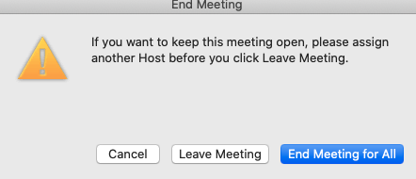
Hosting: Ending Your Meeting
Task Card #7
Goal:
Successfully wrap up your meeting.
While in a live meeting in the bottom right hand corner is “End Meeting.” Click the button.
A pop up will prompt you with three options. Select “End Meeting for All.” This will ensure that when you leave all attendees also are forced out of the meeting (very important when using Zoom with students).
All previous meetings are listed under the Meetings tab by navigating to “Previous Meetings” in the task bar.

Slide 11
Additional Resources to become a Zoom Pro
Task Card #8
Goal:
Understand advanced features of Zoom
Creating Polls for participant feedback and engagement
Using Breakout Rooms for collaborative group work
Utilizing Non-verbal Feedback in meetings
How do I share my screen?
Using Zoom’s built in Whiteboard
How do I use Annotation during meetings?
Creating a transcription of meetings
Using the chat feature to share links and materials
Recording your Zoom session

